Slide 1
JavaScript Day5
JS
Presented By : Asmaa Ahmed

Slide 2
Complete DOM
Propagation in JavaScript refers to the way events are handled and propagated through the DOM (Document Object Model) tree. When an event occurs on an element, such as a click event on a button, it can trigger event handlers not only on that element but also on its parent elements in the DOM hierarchy. This process of propagating events from child elements to their ancestors is known as event propagation or event bubbling.
There are two main phases in event propagation:
Capturing Phase: In this phase, the event is captured by the outermost ancestor and then propagated down to the target element.
Bubbling Phase: Once the event reaches the target element, it starts bubbling up through its parent elements until it reaches the outermost ancestor.
By default, most events in JavaScript follow the bubbling phase. However, you can use the addEventListener method to specify whether you want to handle the event during the capturing phase or the bubbling phase.

Slide 3
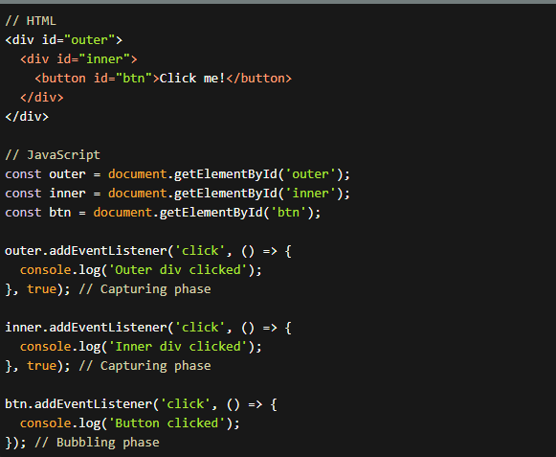
Propagation
if you click the button, the event will first be captured during the capturing phase by the outer div and then the inner div. Finally, it will bubble up during the bubbling phase, triggering the event handler on the button.

Slide 4
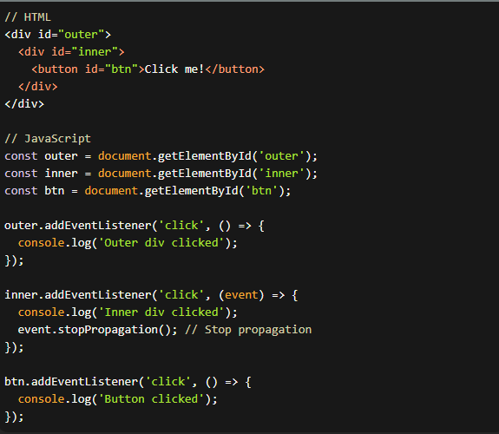
Stop Propagation
To stop the propagation of an event, you can use the stopPropagation method. This method prevents the event from further propagating to its parent elements.

Slide 5
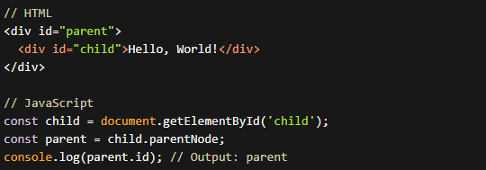
DOM navigation
DOM navigation in JavaScript allows you to traverse and access different elements within the DOM tree. Here are some common methods and properties for navigating the DOM.
1-parentNode:
The parentNode property returns the parent element of a given node.
It allows you to move up one level in the DOM tree.

Slide 6
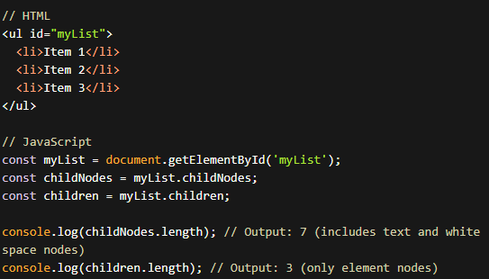
DOM navigation
2-childNodes and children:
The childNodes property returns a collection of all child nodes of a given element node.
The children property returns a collection of only the child elements (excluding text and comment nodes).
Both properties return a NodeList of child nodes.

Slide 7
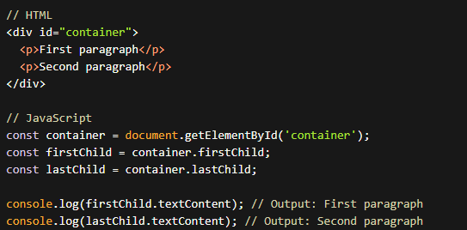
DOM navigation
3-firstChild and lastChild:
The firstChild property returns the first child node of a given element.
The lastChild property returns the last child node of a given element.

Slide 8
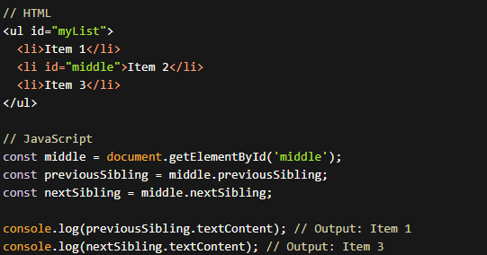
DOM navigation
4-previousSibling and nextSibling:
The previousSibling property returns the previous sibling node of a given node.
The nextSibling property returns the next sibling node of a given node.

Slide 9
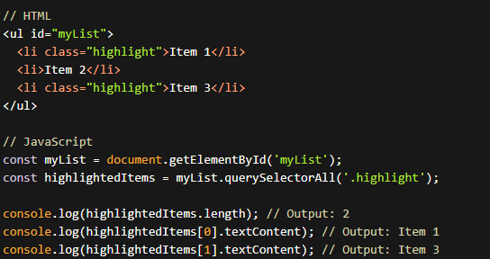
DOM navigation
5-querySelector and querySelectorAll:
The querySelector method returns the first element that matches a specified CSS selector within the given element.
The querySelectorAll method returns a NodeList containing all elements that match a specified CSS selector within the given element.

Slide 10

creating elements, adding content, and appending them
Example: Creating a <div> element, adding text content, and appending it to the document body.
We use the createElement method to create a new <div> element.
We set the text content of the newly created <div> using the textContent property.
Finally, we append the <div> as a child to the body of the document using the appendChild method.

Slide 11
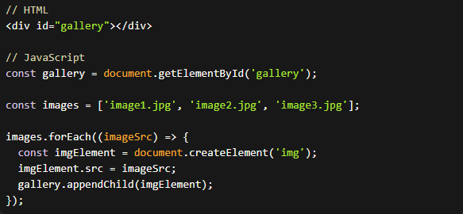
Simple Gallery
We have an empty <div> with the ID "gallery" in the HTML.
We select the gallery element using getElementById.
We define an array of image sources.
Using forEach, we loop through each image source.
Inside the loop, we create an <img> element, set its source (src) attribute to the current image source, and append into the gallery element.

Slide 12
Thanks!
Do you have any questions?
asmaaahmed23762@gmail.com

